Slide 1
Sub Routines – Multiple Parameters

Slide 2
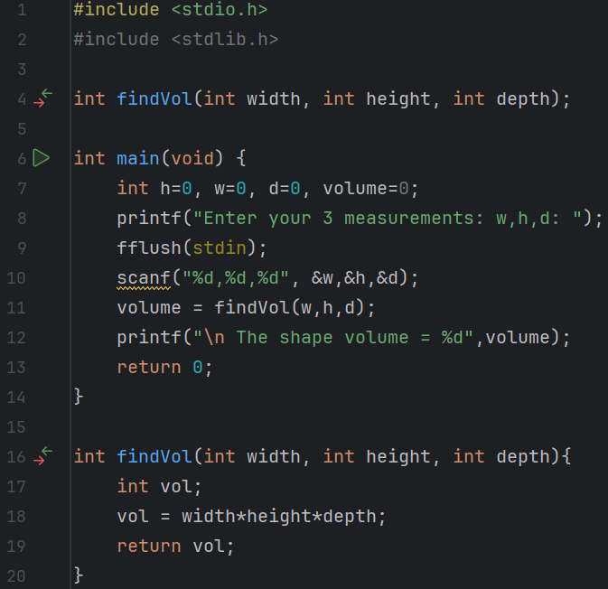
Predict
What do you think this code does?
Asks the user to enter the height, width and depth of a shape. It then passes these as parameters to the function findVol, which multiplies them and returns the volume to the main program.

Slide 3
Run
What does the code do?
Asks the user to enter the height, width and depth of a shape. It then passes these as parameters to the function findVol, which multiplies them and returns the volume to the main program.
Does this match your prediction?
Yes.
Download the code from Github and run it!

Slide 4
Investigate
Investigation Activities
What are the name of the variables being used? Width, height, depth, volume What data types do they hold?integers What are the names of the functions?findVol What type of data do these return?integer Annotate lines 4-19 to explain what each line of code does.

Slide 5
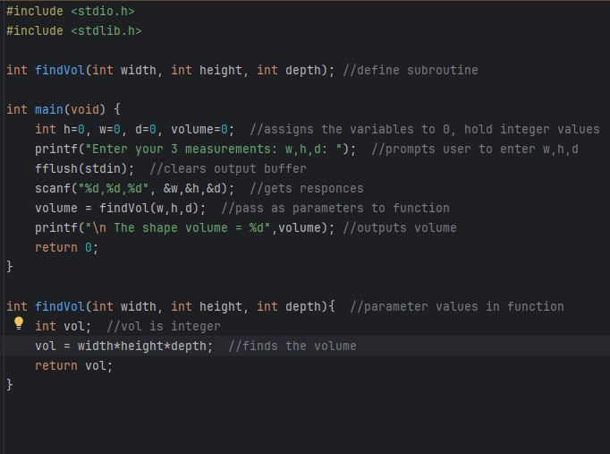

Slide 6
Modify
Modification Activities
Modify the program to find the area of a triangle. Modify the program to find the area of a circular. Modify the program to find the volume of a sphere.

Slide 7
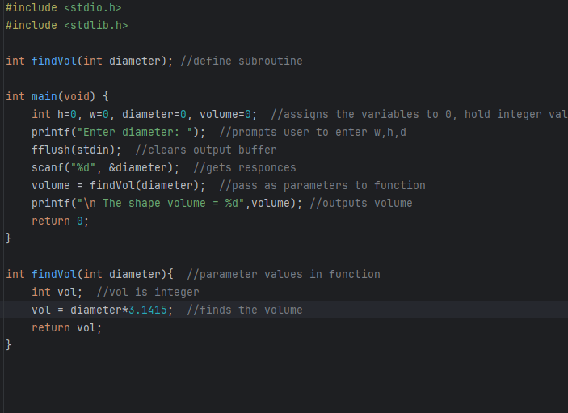
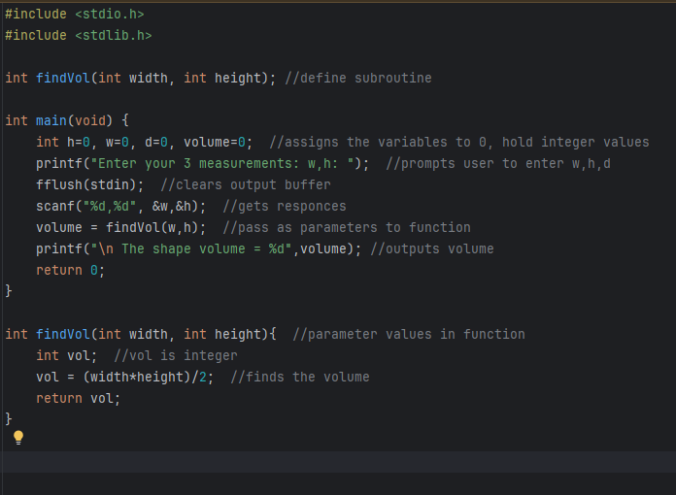
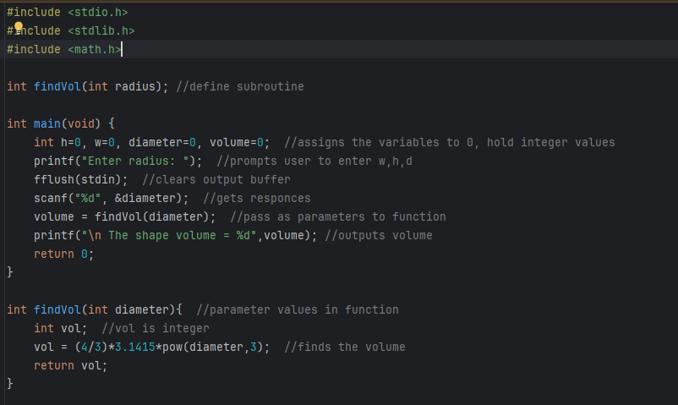
volume of a triangle.
volume of a circle.
volume of a sphere.

Slide 8
Make
Make Activities
Write a calculator program so that each case statement calls a separate function to carry out the chosen operation. Requirements: The program should ask the user to enter two integers Each Case statement for +, -, * and / should then call a function add(), sub(), mult() or div() The two input numbers should be passed into the functions as parameters Each function should return its calculated value back to the main() function, where the result of the sum should be output

Slide 9
